Slide 1
Drugs and Gluttony
Nathaniel Brown
Guan-Wun Hao
Corey Vernot
Notes:
Names, project, BECR(Center for Behavioral Economics and Healthy Food Choice Research)

Slide 2
Outline
Introduction
Motivation / Goals
Data Description
Metformin
Previous Studies
Our niche
Data Cleaning
Exploratory Analysis
Model
Future Work

Slide 3
Motivation / Goals
Diet effects health outcomes for many diseases / medical conditions
diabetes, depression, etc.
Plausible that being prescribed medication can effect nutrition choices
appetite, awareness of health benefits, etc.
Goals:
Answer question: Do individuals change nutrition choices because of their prescriptions?
Initially working with diabetes, may apply to other diseases later
R Software package for health researchers w/ access to our database
Notes:
Dataset comes from grocery shopping
(Not including food consumption in restaurants, free food, etc.)
Besides Metformin(Type II Diabetes drug), we have been working on antidepressants and we may be working on other drugs in the future. But we will only focus on diabetes in this presentation.
p.s. we also start looking at SSRI(Selective serotonin reuptake inhibitors), which is a common antidepressants for the treatment of depression and anxiety.

Slide 4
What are we trying to measure?
Change in nutrition decisions after starting a new prescription as first type II diabetes drug
effect of drug
effect of visit to doctor
sometimes effect of diagnosis

Slide 5
Data Description
Information Resources, Incorporated (IRI)
Professional data compilers and providers
Food Transactions (2008-2012)
obs. is one item purchased
Prescription Drug Fills (2010-2012)
obs. is one fill of a prescription drug
Demographic Information (2012)
each row is one individual (110,000 total)
MedProfile (2010-2012)
each row is one individual
The Duke-UNC USDA Center for Behavioral Economics and
Healthy Food Choice Research (BECR)
Nutrition Information
The nutrition information in IRI is incomplete
Notes:
1. Missing data
2. Transactions we don’t observe within the time period(for example, 2000 calories)
3. Data which we don’t observe off the window

Slide 6
Drug Selection
Clean Relevant Data
Exploratory Analysis
Modeling
Future Work
Q & A

Slide 7
Metformin

Slide 8
Previous Studies
Metformin is the most common drug for initial treatment of type II diabetes.
It is used by around 60.5% of diabetic adults on anti-diabetic medication.
Metformin has been linked to decreased food intake and appetite in laboratory settings.
Metformin can cause weight loss in real world setting.

Slide 9
Our Niche
There hasn’t been research on whether Metformin changes purchasing behavior, or changes the intake of any specific nutrients in a real world setting.

Slide 10
Drug Selection
Clean Relevant Data
Exploratory Analysis
Modeling
Future Work
Q & A

Slide 11
Which Individuals to Use?

Slide 12
Recall…
We are initially trying to measure the following:
Change in nutrition decisions after starting a new prescription as the first type II diabetes drug
effect of drug
effect of visit to doctor
sometimes effect of diagnosis

Slide 13
Which individuals to use?
Keep individuals who:
used metformin during the study period 3,600
are in a single person household 752
started their Metformin prescription in time window 213
didn’t use other diabetes drugs first in time window 101
Doesn’t eliminate possibility of using other diabetes drugs before the time window – not perfect
Notes:
Study period: 2010-2012
Single person household: actual food intake
Time window: 2010-2012

Slide 14
Aggregating Data
Time-unit (4 weeks) instead of months
Equal number of weekends / week-days
Aggregated by summing mass purchased of each nutrient during each time-unit
Defined K to be the number of time-units after the start of prescription
Problem: Only observe about 2,000 calories per day (not 2,700 US average)
T = 30
T = 50
T = 62
T = 74
T = 90
K = -12
Prescription Start Date:
K = 0
K = 12

Slide 15
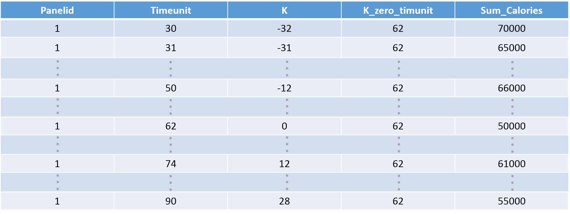
Individual
T = 30
T = 50
T = 62
T = 74
T = 90
K = -12
Prescription Start Date:
K = 0
K = 12

Slide 16
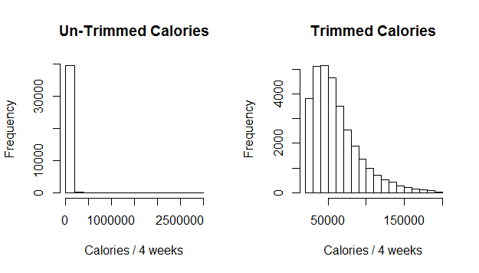
Trimming Outliers
800 < calories / day < 7000 (before analysis)
2 s.d. above or below average nutrition consumption for individual over the time period (during plotting / modeling specific nutrients)
These are parameters within our package

Slide 17
Drug Selection
Clean Relevant Data
Exploratory Analysis
Modeling
Future Work
Q & A

Slide 18
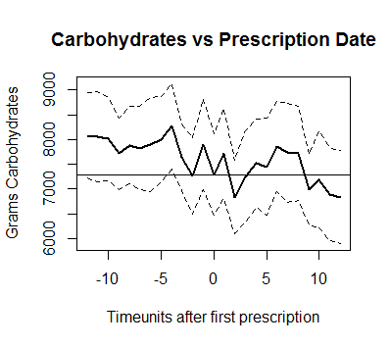
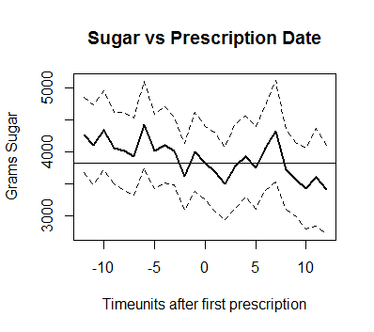
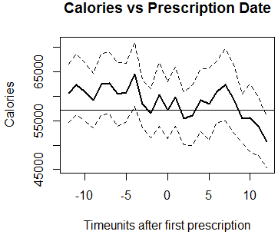
101 individuals
Notes:
101 sample size
Average grams of carbohydrates consumed in per time unit from 12 timeunits before the first prescription to 12 timeunits after the first prescripion

Slide 19
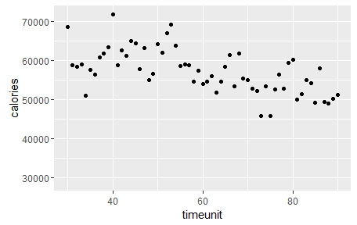
Calories vs. Time
101 individuals
Notes:
Sample size: 101

Slide 20
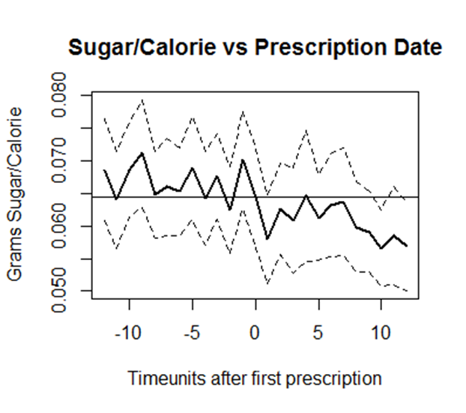
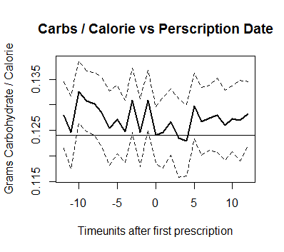
Nutrient / Calorie vs. Prescription Date
101 individuals
Notes:
Decrease variance

Slide 21
Drug Selection
Clean Relevant Data
Exploratory Analysis
Modeling
Future Work
Q & A

Slide 22
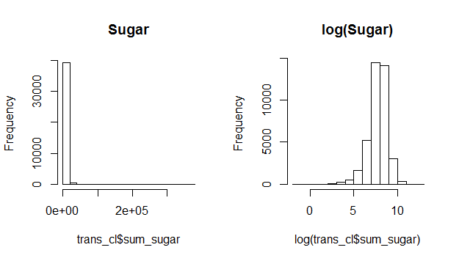

Model
$\log\left(Y_{it}\right)= α_{t}+γ_{i}+δ_{it}^{k}$
$Y_{it}:$ level of dependent variable at time t for individual i
$α_{t}$: indicator variable for time unit; controls for time-specific variables such as seasons, holidays, etc.
$γ_{i}$: indicator variable for person; controls for individual-specific, time-invariant variables such as race, permanent eating habits, etc.
$δ_{it}^{k}$: indicator variable for number of time units before/after first Metformin prescription.

Slide 23
F test: P = 0.21, H₀: All coefficients for K are 0

Slide 24
Problems with analysis until now
Measuring changes in absolute mass of nutrient (sum of all sugar consumed in a time period)
These changes are driven by how much data we observe, not actual consumption
Very imprecise
Measuring change in mass of nutrient / calorie consumed
Assumes calories are consistent over time
Doesn’t account for decreases in overall food consumption
We expect food consumption to decrease due to Metformin effect on appetite

Slide 25
Propensity Score Matched Control Group
All Single Individuals Without Diabetes or Metformin
752 Single Metformin Users
Demographically similar control group
Propensity Score Matching

Slide 26
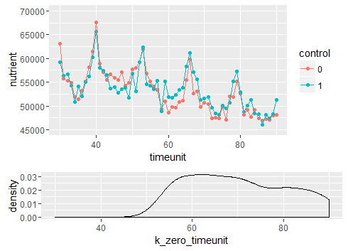
Calories over time (control vs. full sample)
752 individuals
Notes:
Decrease the variance

Slide 27
Drug Selection
Clean Relevant Data
Exploratory Analysis
Modeling
Future Work
Q & A

Slide 28
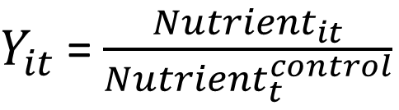
Future Work
Normalizing nutrient levels based on averages for control group
$\log\left(Y_{it}\right)= α_{t}+γ_{i}+δ_{it}^{k}$
$Y_{it}$ = $\frac{{Nutrient}_{it}}{{Nutrient}_{t}^{control}}$
= $\frac{Total mass of nutrient purchased in time unit t by individual i}{Average mass of nutrient purchased in time t by control group}$

Slide 29

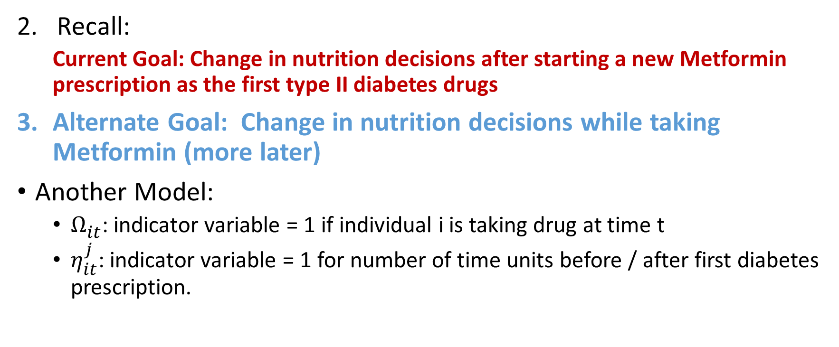
Future Work (cont.)
Recall:
Current Goal: Change in nutrition decisions after starting a new Metformin prescription as the first type II diabetes drugs
Alternate Goal: Change in nutrition decisions while taking Metformin (more later)
Another Model:
$Ω_{it}^{ }$: indicator variable = 1 if individual i is taking drug at time t
$η_{it}^{j }$: indicator variable = 1 for number of time units before / after first diabetes prescription.
$\log\left(Y_{it}\right)= α_{t}+γ_{i}+η_{it}^{j}+Ω_{it}^{ }$

Slide 30
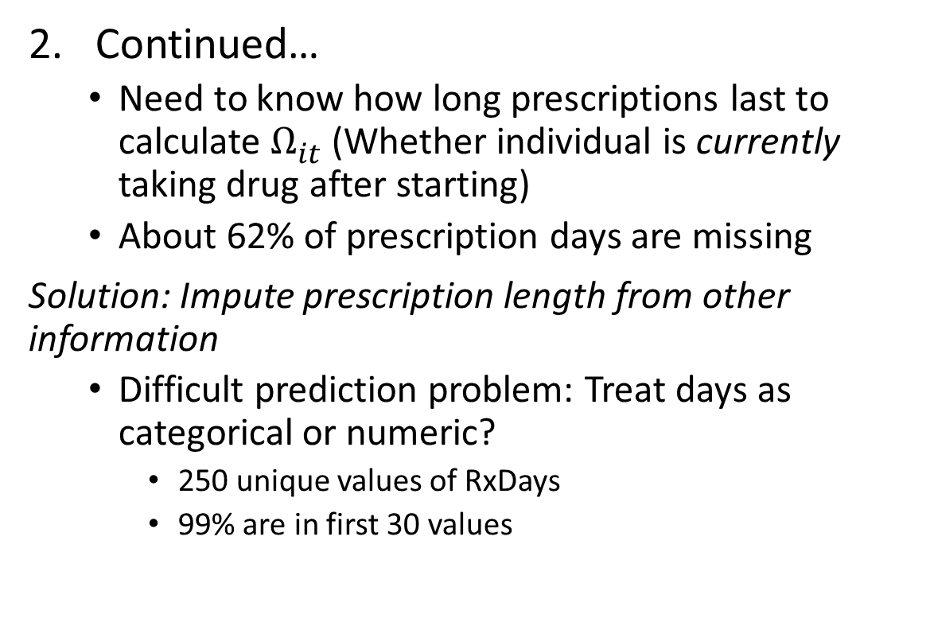
Future Work (cont.)
Continued…
Need to know how long prescriptions last to calculate $Ω_{it}^{ }$ (Whether individual is currently taking drug after starting)
About 62% of prescription days are missing
Solution: Impute prescription length from other information
Difficult prediction problem: Treat days as categorical or numeric?
250 unique values of RxDays
99% are in first 30 values

Slide 31
Q & A

Slide 32
Balanced Covariates between Control and treatment group
 | Population | Control
Income
Hispanic |  |  |  | t = 40 | t = 0.07
Married
Rent / Own
Age
Sex
Weight_Concern
Stress_Concern
Obesity
max <-------> min
Notes:
def of control group

Slide 33
Understanding the Data
Demo (IRI) | MedProf (IRI) | Food Purchases (IRI) | Rx (IRI) | Nutrition Info (BECR)
age sex race household info id size income | weight / height medical conditions acne obesity lifestyle choices exercise | date upc category oz floz quantity | brands medical condition new/refill/sample # days week | calories cholesterol fat sugar carbs
IRI: Information Resources, Incorporated
BECR: The Duke-UNC USDA Center for Behavioral Economics and Healthy Food Choice Research

Slide 34
Demographic Info
Sex | Race | Age | Marital | Rent/Own | Region | Household Size
Female 69% Male 31% | White 90% Black 9% Other 1% | <50 16% 50-59 40% 60-69 30% 70+ 15% | Married 2% Divorced/Separated 43% Single 38% Widowed 18% | Owner 65% Renter 31% Other 4% | South 39% Northeast 26% Midwest 22% West 14% | 1 100%

Slide 35
Demographic Info (cont.)
Education | Grade School 0% Some High School 2% Graduated High School 17% Some College 38% Graduated College 32% Post Graduate School 12% No Household Head Present 0%
Household Income (per yr) | $00,000-$9,999 6% | $10,000-$11,999 5% | $12,000-$14,999 9% | $15,000-$19,999 13% | $20,000-$24,999 11% | $25,000-$34,999 17%
 | $35,000-$44,999 9% | $45,000-$49,999 7% | $50,000-$59,999 10% | $60,000-$69,999 5% | $70,000-$99,999 7% | $100,000+ 2%

Slide 36
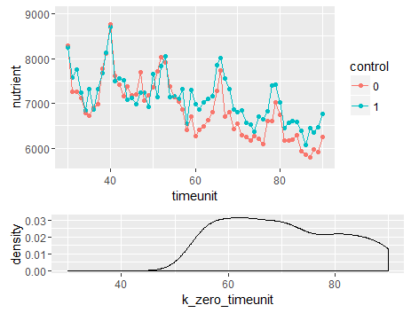
Carbohydrates over time (control vs. full sample)
752 individuals

Slide 37
References
Kuo, C. C., Yeh, H. C., Chen B., Tasi, C. W., Lin, Y. S., & Huang, C. C. (2015). Prevalence of Metformin Use and te Associated Risk of Metabolic Acidosis in US Diabetic Adults With CKD: A National Cross-Sectional Study. Medicine (Baltimore), 94(51). Doi:10.1097/md.0000000000002175
Number (in Millions) of Civilian, Non-institutionalized Adults with Diagnosed Diabetes, United States, 1980-2014. (2015). Retrieved June 14, 2016, from http://www.cdc.gov/diabetes/statistics/prev/national/figadults.htm
Metformin Side Effects in Detail – Drugs.com. (n.d.). Retrieved June 14, 2016, from http://www.drugs.com/sfx/metformin-side-effexts.html

Slide 38
References (cont.)
Lee, A., & Morley, J. E. (1998). Metformin Decreases Food Consumption and Induces Weight Loss in Subjects with Obesity with Type II Non-Insulin-Dependent Diabetes. Obesity Research, 6(1), 47-53, doi:10.1002/j.1550-8528.1998.tb00314.x
Seifarth, C., Schehler, B., & Schneider, H. (2013). Effectiveness of metformin on weight loss in non-diabetic individuals with obesity. Exp Clin Endocrinol Diabetes, 121(1), 27-31
Malin, S. K., & Kashyap, S. R. (2014). Effects of metformin on weight loss: potential mechanisms. Current Opinion in Endocrinology, Diabetes and Obesity, 21(5), 323-329. doi: 10.1097/med.0000000000000095

